Slide 1
Summary: Water has the following unique combination of qualities:
A) H₂O molecules form hydrogen bonds with each other. They are cohesive.
B) H₂O molecules like to bond with ions or other charged molecules. They are adhesive.
C) Because water bonds easily with other ions, it is the “universal solvent”.
D) Water has a high specific heat.
E) Water has a high heat of vaporization.
F) Water’s greatest density is at 4°C. Above or below that temperature it becomes less dense.
G) Water has a low viscosity.
Notes:
We’ve learned a lot about water, and here is a summary of some key points. Review each of these statements and make sure you understand it and could apply it. In class we will do an exercise where we will apply these concepts to situations involving water in every day life. If you go back to review, be sure to follow the embedded hyperlinks in the accompanying powerpoint for more information and review. Thanks for listening!

Slide 2
Scenario 1: It is a hot day at an outdoor concert. You walk through a misting booth, and for a few minutes afterward you feel much cooler.
This photo by Unknown Author is licensed under CC BY-SA

Slide 3
1: It is a hot day at an outdoor concert. You walk through a misting booth, and for a few minutes afterward you feel much cooler.
A) H₂O molecules form hydrogen bonds with each other. They are cohesive.
B) H₂O molecules like to bond with ions or other charged molecules. They are adhesive.
C) Because water bonds easily with other ions, it is the “universal solvent”.
D) Water has a high specific heat.
E) Water has a high heat of vaporization.
F) Water’s greatest density is at 4°C. Above or below that temperature it becomes less dense.
G) Water has a low viscosity.
This photo by Unknown Author is licensed under CC BY-SA

Slide 4
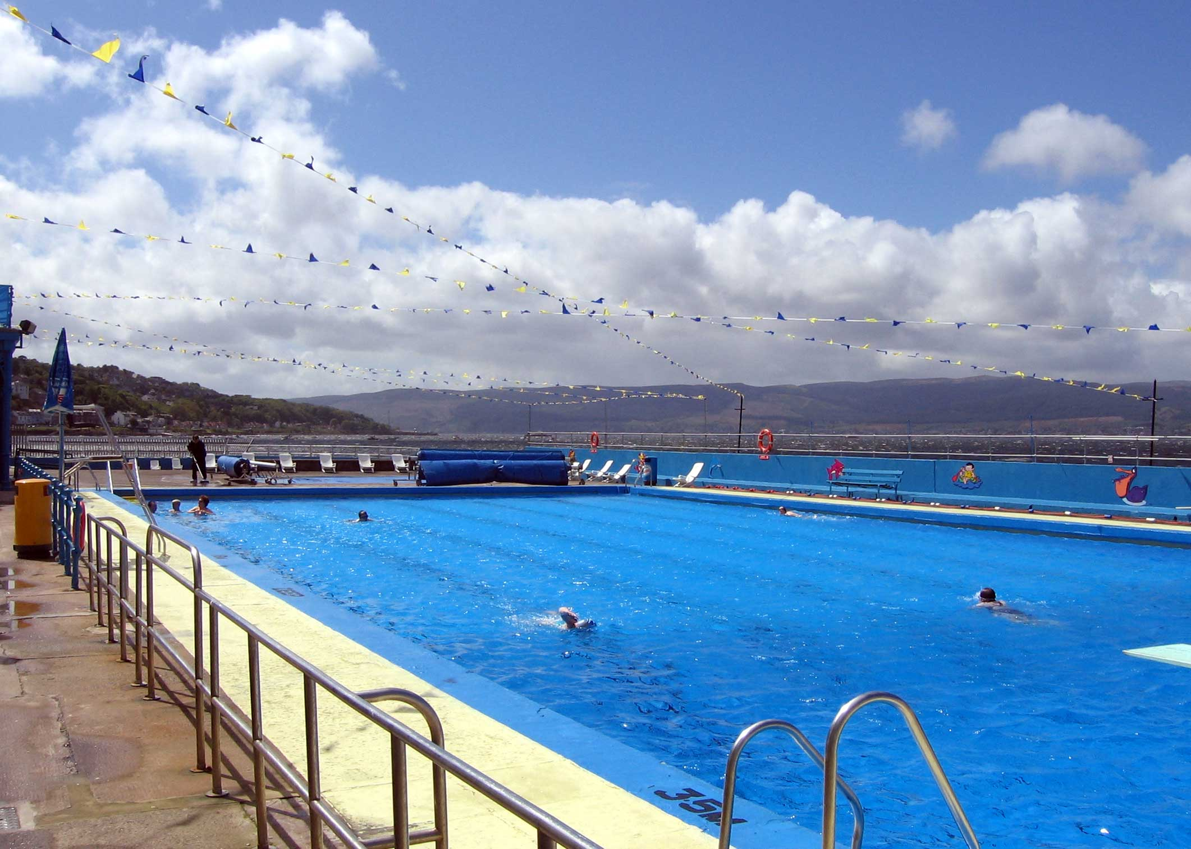
Scenario 2: You’re on a road trip through the desert. You stay in a hotel with a swimming pool. Even though it’s been scorching hot all day, you dive in without fear.
This photo by Unknown Author is licensed under CC BY-SA

Slide 5
2: You’re on a road trip through the desert. You stay in a hotel with a swimming pool. Even though it’s been scorching hot all day, you dive in without fear.
A) H₂O molecules form hydrogen bonds with each other. They are cohesive.
B) H₂O molecules like to bond with ions or other charged molecules. They are adhesive.
C) Because water bonds easily with other ions, it is the “universal solvent”.
D) Water has a high specific heat.
E) Water has a high heat of vaporization.
F) Water’s greatest density is at 4°C. Above or below that temperature it becomes less dense.
G) Water has a low viscosity.
This photo by Unknown Author is licensed under CC BY-SA

Slide 6
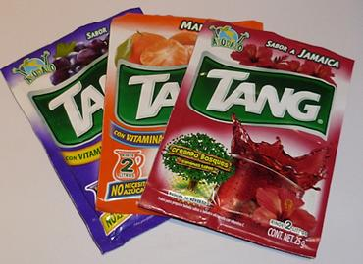
Scenario 3: You go for a hike, and decide to add powdered flavoring to your water bottle. You sprinkle in the powder and it quickly dissolves.
This photo by Unknown Author is licensed under CC BY-SA

Slide 7
3: You go for a hike, and decide to add powdered flavoring to your water bottle. You sprinkle in the powder and it quickly dissolves.
A) H₂O molecules form hydrogen bonds with each other. They are cohesive.
B) H₂O molecules like to bond with ions or other charged molecules. They are adhesive.
C) Because water bonds easily with other ions, it is the “universal solvent”.
D) Water has a high specific heat.
E) Water has a high heat of vaporization.
F) Water’s greatest density is at 4°C. Above or below that temperature it becomes less dense.
G) Water has a low viscosity.
This photo by Unknown Author is licensed under CC BY-SA

Slide 8
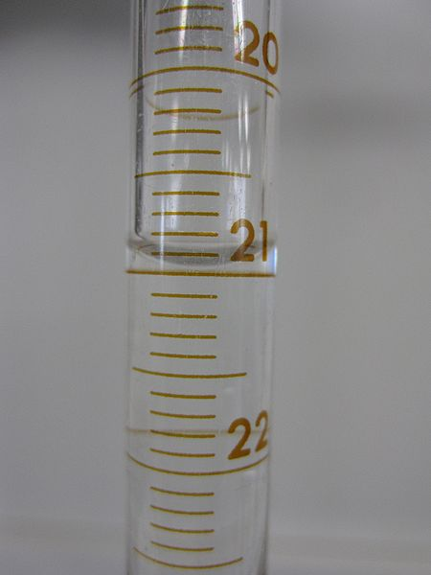
Scenario 4: In chemistry class, you pour water into a graduated cylinder. You carefully take note of the meniscus that formed at the top.
Image licensed under the Creative Commons Attribution-Share Alike 3.0 Unported license

Slide 9
4: In chemistry class, you pour water into a graduated cylinder. You carefully take note of the meniscus that formed at the top.
A) H₂O molecules form hydrogen bonds with each other. They are cohesive.
B) H₂O molecules like to bond with ions or other charged molecules. They are adhesive.
C) Because water bonds easily with other ions, it is the “universal solvent”.
D) Water has a high specific heat.
E) Water has a high heat of vaporization.
F) Water’s greatest density is at 4°C. Above or below that temperature it becomes less dense.
G) Water has a low viscosity.
Image licensed under the Creative Commons Attribution-Share Alike 3.0 Unported license

Slide 10
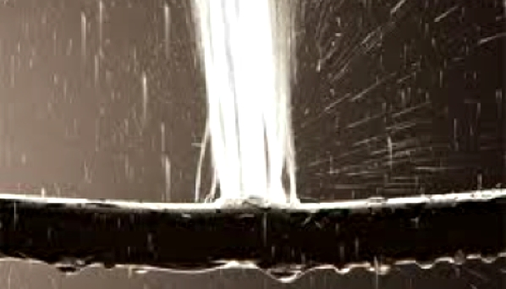
Scenario 5: An Arctic blast comes through town. The next day, the plumbers are busy as pipes burst all over town.
This Photo by Unknown Author is licensed under CC BY-NC-SA

Slide 11
5: An Arctic blast comes through town. The next day, the plumbers are busy as pipes burst all over town.
A) H₂O molecules form hydrogen bonds with each other. They are cohesive.
B) H₂O molecules like to bond with ions or other charged molecules. They are adhesive.
C) Because water bonds easily with other ions, it is the “universal solvent”.
D) Water has a high specific heat.
E) Water has a high heat of vaporization.
F) Water’s greatest density is at 4°C. Above or below that temperature it becomes less dense.
G) Water has a low viscosity.
This Photo by Unknown Author is licensed under CC BY-NC-SA

Slide 12
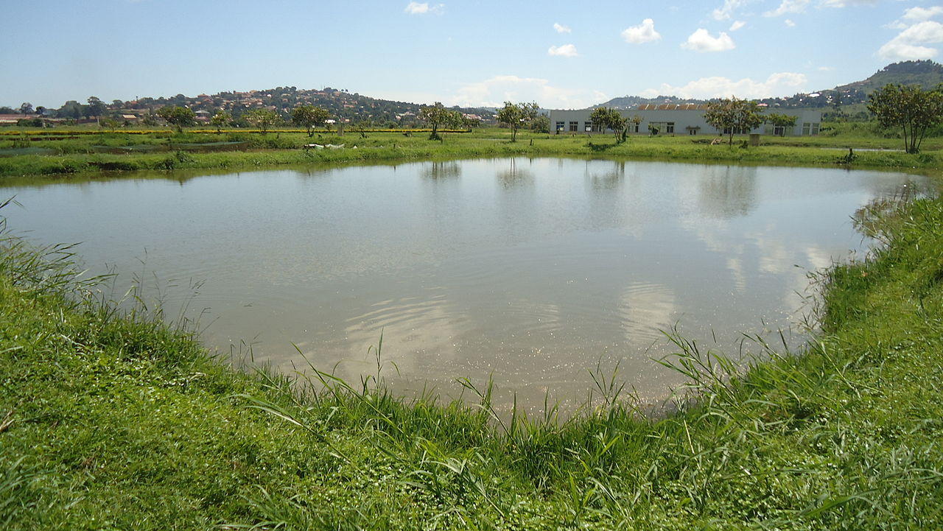
Scenario 6: You have a fishing pond full of catfish. The winter is unusually cold and the pond ices over and stays that way all winter. The next spring the ice melts and the pond is still full of fish.
This Photo by Unknown Author is licensed under CC BY-NC-SA

Slide 13
6: You have a fishing pond full of catfish. The winter is unusually cold and the pond ices over and stays that way all winter. The next spring the ice melts and the pond is still full of fish.
A) H₂O molecules form hydrogen bonds with each other. They are cohesive.
B) H₂O molecules like to bond with ions or other charged molecules. They are adhesive.
C) Because water bonds easily with other ions, it is the “universal solvent”.
D) Water has a high specific heat.
E) Water has a high heat of vaporization.
F) Water’s greatest density is at 4°C. Above or below that temperature it becomes less dense.
G) Water has a low viscosity.
This Photo by Unknown Author is licensed under CC BY-NC-SA

Slide 14
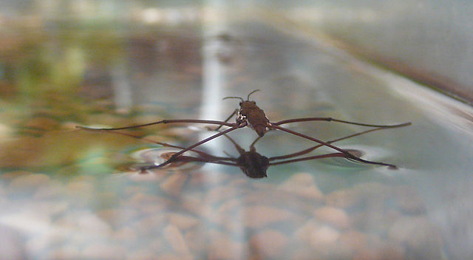
Scenario 7: While sitting by the edge of a stream, you observe that some insects can actually walk on the surface of the water without falling through.
This Photo by Unknown Author is licensed under CC BY-NC-SA

Slide 15
7: While sitting by the edge of a stream, you observe that some insects can actually walk on the surface of the water without falling through.
A) H₂O molecules form hydrogen bonds with each other. They are cohesive.
B) H₂O molecules like to bond with ions or other charged molecules. They are adhesive.
C) Because water bonds easily with other ions, it is the “universal solvent”.
D) Water has a high specific heat.
E) Water has a high heat of vaporization.
F) Water’s greatest density is at 4°C. Above or below that temperature it becomes less dense.
G) Water has a low viscosity.
This Photo by Unknown Author is licensed under CC BY-NC-SA

Slide 16
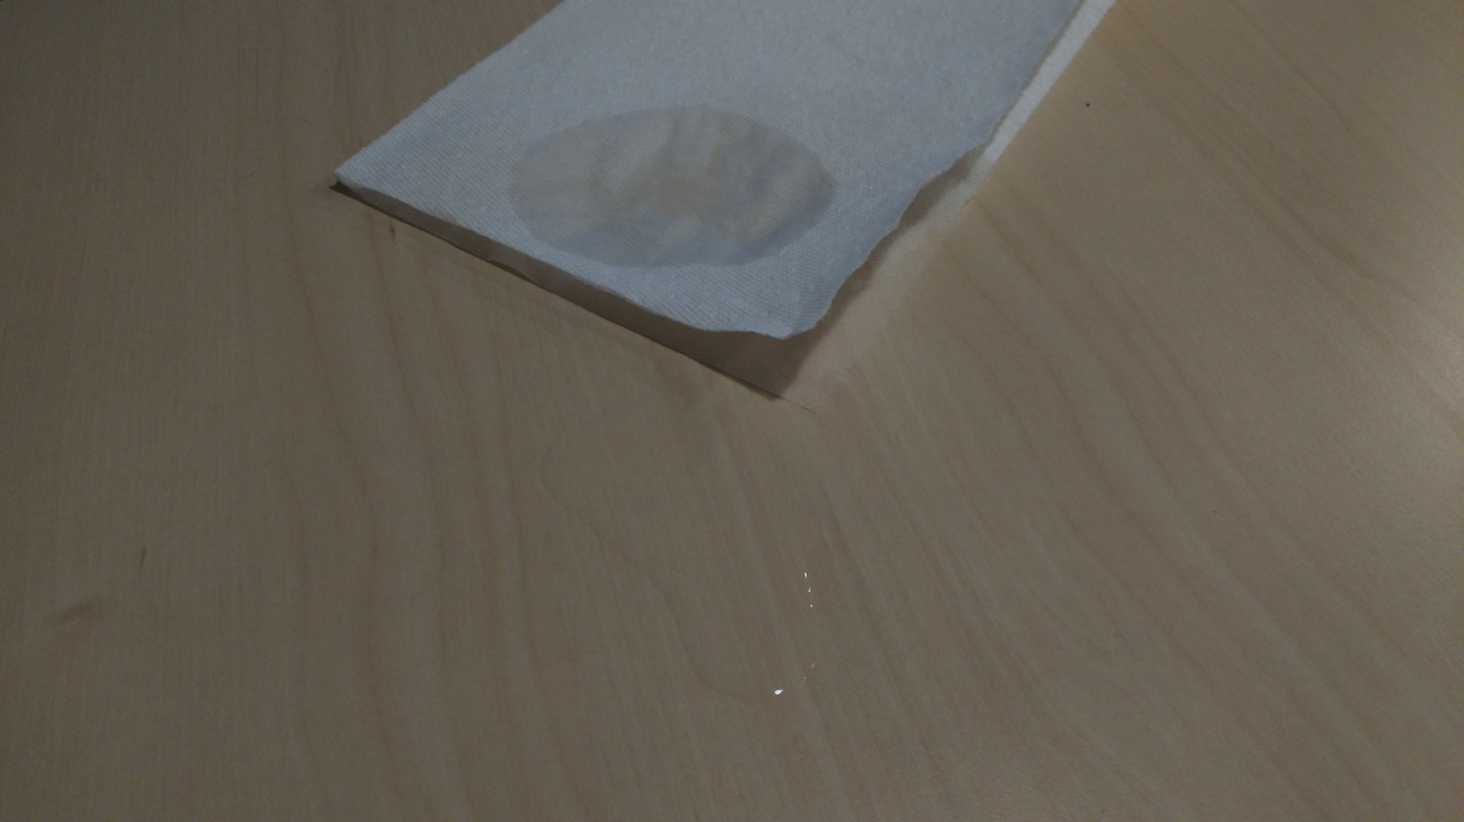
Scenario 8: You touch the edge of a paper towel to a puddle of water. Very quickly the paper towel absorbs the water.
Photo: R. Freeman

Slide 17
8: You touch the edge of a paper towel to a puddle of water. Very quickly the paper towel absorbs the water.
A) H₂O molecules form hydrogen bonds with each other. They are cohesive.
B) H₂O molecules like to bond with ions or other charged molecules. They are adhesive.
C) Because water bonds easily with other ions, it is the “universal solvent”.
D) Water has a high specific heat.
E) Water has a high heat of vaporization.
F) Water’s greatest density is at 4°C. Above or below that temperature it becomes less dense.
G) Water has a low viscosity.
Photo: R. Freeman

Slide 18
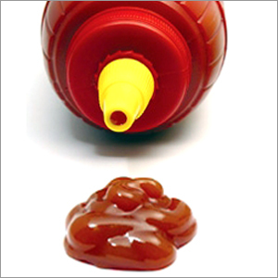
Scenario 9: You can’t get the last little bit of ketchup out of the bottle. You decide to add a little water to help.
This Photo by Unknown Author is licensed under CC BY-NC-SA

Slide 19
9: You can’t get the last little bit of ketchup out of the bottle. You decide to add a little water to help.
A) H₂O molecules form hydrogen bonds with each other. They are cohesive.
B) H₂O molecules like to bond with ions or other charged molecules. They are adhesive.
C) Because water bonds easily with other ions, it is the “universal solvent”.
D) Water has a high specific heat.
E) Water has a high heat of vaporization.
F) Water’s greatest density is at 4°C. Above or below that temperature it becomes less dense.
G) Water has a low viscosity.
This Photo by Unknown Author is licensed under CC BY-NC-SA

Slide 20
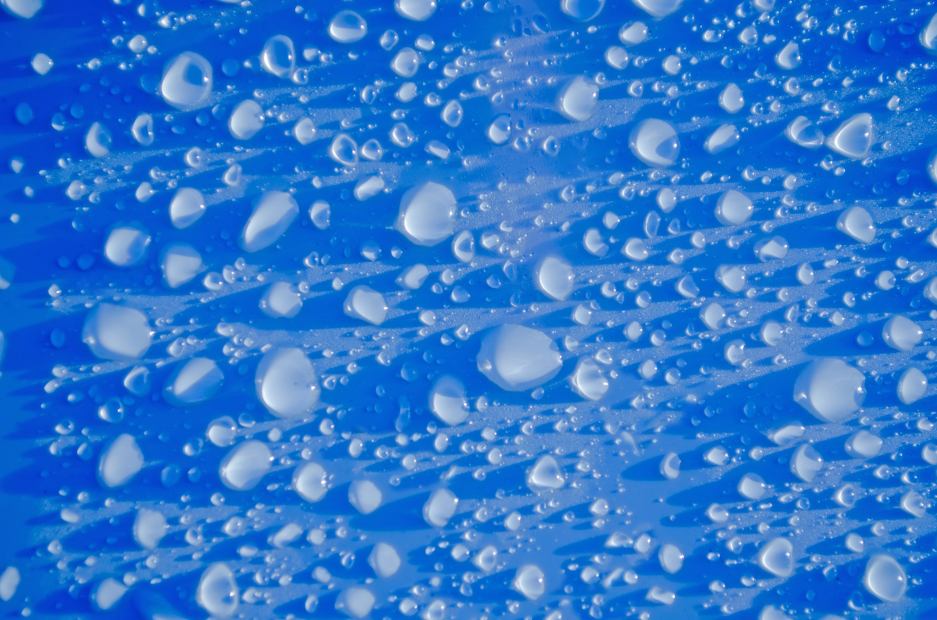
Scenario 10: As raindrops fall on a solid surface, they quickly tend to form beads or drops.
This Photo by Unknown Author is licensed under CC BY-NC-SA

Slide 21
10: As raindrops fall on a solid surface, they quickly tend to form beads or drops.
A) H₂O molecules form hydrogen bonds with each other. They are cohesive.
B) H₂O molecules like to bond with ions or other charged molecules. They are adhesive.
C) Because water bonds easily with other ions, it is the “universal solvent”.
D) Water has a high specific heat.
E) Water has a high heat of vaporization.
F) Water’s greatest density is at 4°C. Above or below that temperature it becomes less dense.
G) Water has a low viscosity.
This Photo by Unknown Author is licensed under CC BY-NC-SA

